Slide 1
CV Final Presentation
Yunke Tian
109929662

Slide 2
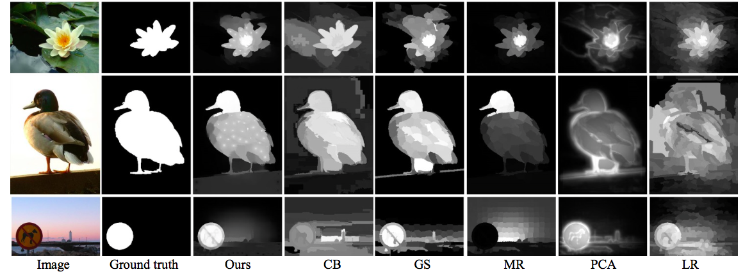
Brief View
Topic: Robust Saliency Detection via Regularized Random Walks Ranking
What’s special:
1. In the background saliency detection phase, use manifold ranking to remove one erroneous boundary of the four → Accurate & Robust
2. While measuring foreground saliency, use regularized random walks ranking to formulate pixel-wised saliency maps → accurate & detail preserved.

Slide 3
What I implemented
Background Saliency Detection
1. Establish the graph structure with superpixels as nodes ( SLIC: simple linear iterative clustering )
2. Compute weight matrix between superpixel nodes Wij
2.a. Decide connectivity between superpixel nodes
2.b. Convert image from RGB to Lab and compute Lab average for every node
2.c. Compute weight matrix
3. Sum Wij according to columns → di

Slide 4
What I implemented
4. Erroneous boundary removal
4.a Determine boundary superpixels
4.b Histogram boundary superpixels using 256 bins
4.c Compute Euclidean distance between histograms and remove the most faraway boundary.
5. Compute manifold ranking values of the 3 remaining boundaries, f
6. Compute S_step1 which indicate the background relevance of each node.

Slide 5
What I implemented
Foreground Saliency Detection
7. Thresholding S_step1 and compute foreground saliency estimation S_step2.
Saliency Map Formulation by Regularized Random Walks Ranking
8. Establish the pixel-wise graph structure
9. Compute Laplacian matrix L
10. Differentiate Dirichlet integral
11. Use the S_step2 as seeds and categorize seeds into background and fore ground.
12. With regard to foreground seeds, perform random walk ranking to compute the possibility of each non-seed to be foreground.

Slide 6
What I implemented
13. Re-forming the result into saliency map and output.
14. refine the output.
15. evaluate accuracy

Slide 7

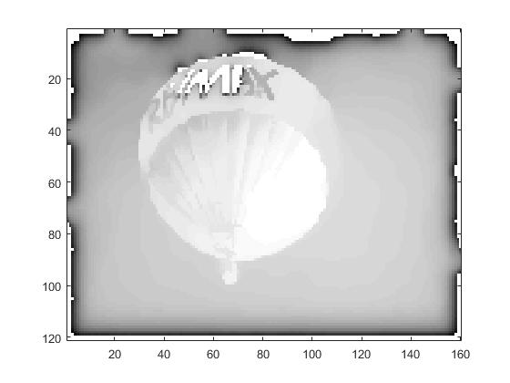
Outputs

Slide 8
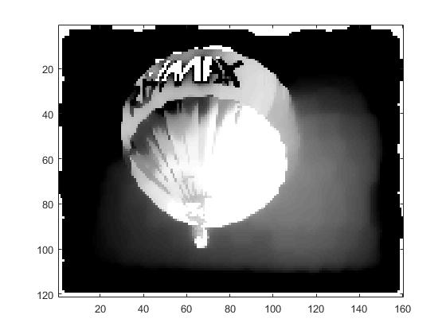
Outputs

Slide 9
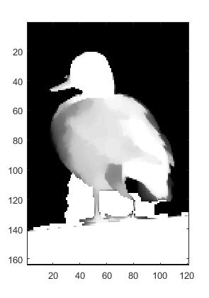
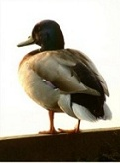
Outputs

Slide 10
Outputs

Slide 11
Difficulties
1. Limit of picture size (16GB Ram, for 150*150 resolution)
2. Algorithm not clearly specified

Slide 12

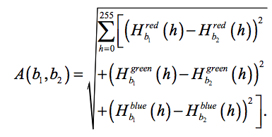
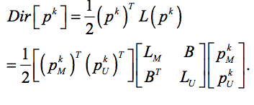
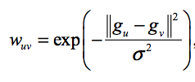
Difficulties
1. Limit of picture size (16GB Ram, for 150*150 resolution)
2. Algorithm not clearly specified

Slide 13

Difficulties
1. Limit of picture size (16GB Ram, for 150*150 resolution)
2. Algorithm not clearly specified
3. Parameters hard to tune
4. Failure with complex pictures

Slide 14
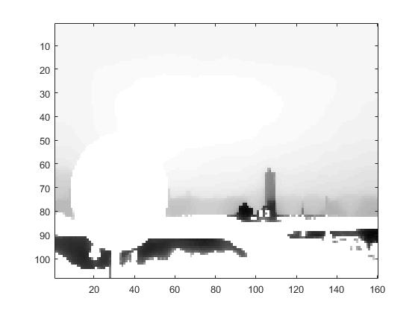

Difficulties
1. Limit of picture size (16GB Ram, for 150*150 resolution)
2. Algorithm not clearly specified
3. Parameters hard to tune
4. Failure with complex pictures

Slide 15
Evaluation

Slide 16
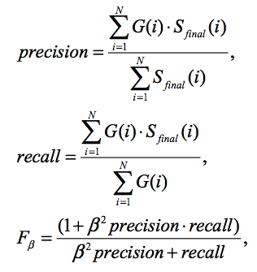
Evaluation
Precision = 0.5276
Recall = 0.7638
F = 0.5642
Works just fine!

Slide 17
Failed to do…
Output not perfect
No comparison with state-of-the-art

